Slide 1

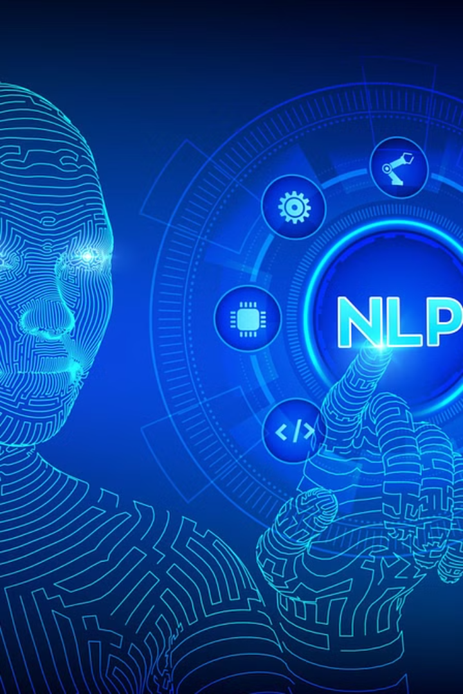
CSA-1337: THEORY OF COMPUTATION FOR LOGICAL MODELS
NLP Language Identifier
Natural language processing (NLP) is a field of artificial intelligence that enables computers to understand, interpret, and generate human language. The language identifier is a critical NLP task that determines the language of a given text input.
GUIDED BY:
DR. ANITHA.C
BY:
Y. Rajesh kumar reddy(192211902)

Slide 2


Introduction to Language Identification
1
Understanding Language Diversity
2
Practical Applications
Unlock the potential of language identification in various industries, from content moderation to multilingual customer support.
Explore the vast landscape of global languages and their unique characteristics.
3
Challenges and Opportunities
Delve into the complexities and cutting-edge solutions in this dynamic field of NLP.

Slide 3
Importance of Language Identification
Accurate language identification is essential for various NLP applications, such as multilingual text processing, translation systems, and information retrieval. It enables efficient processing and analysis of diverse content, improves the accuracy of language-specific tasks, and enhances user experience in applications requiring language-aware functionality.

Slide 4

Approach to Language Identification
Data Preparation
1
Acquire a diverse dataset, clean and preprocess the text, and label each sample with its corresponding language.
2
Feature Extraction
Extract linguistic features like character n-grams, word n-grams, TF-IDF, and word embeddings.
Classification
3
Train a supervised machine learning classifier to predict the language of unseen text samples.

Slide 5
Experimental Evaluation
Methodology
Results
Discussion
Assess the method's accuracy, precision, recall, and F1 score using a diverse dataset.
Demonstrate the effectiveness of the approach through quantitative and graphical performance metrics.
Analyze the strengths, weaknesses, and potential improvements of the language identification method.

Slide 6

Related Work
1
Existing Approaches
2
Advantages
Comparison to previous language identification methods, highlighting differences in methodology and performance.
Discuss the advantages of the proposed approach, such as improved accuracy and robustness.
3
Limitations
Acknowledge the limitations of the current method and opportunities for further improvement.

Slide 7

Future Enhancements
Linguistic Features
Ensemble Methods
Incorporate additional linguistic features to enhance the language identification capabilities.
Explore the use of ensemble techniques for improved classification performance.
Domain-specific Models
Investigate the development of domain-specific language models for specialized applications.

Slide 8




Conclusion
Novel Approach
Presents a novel method for language identification using machine learning and linguistic features.
Effectiveness
Demonstrates the effectiveness of the approach through experimental evaluation.
Implications
Discusses the implications of the language identifier for future research and applications in NLP.

Slide 9



Diverse Applications
Translation
Information Retrieval
Sentiment Analysis
Enables efficient multilingual text processing and translation systems.
Enhances the accuracy of language-specific information retrieval tasks.
Improves the performance of language-aware NLP tasks like sentiment analysis.

Slide 10

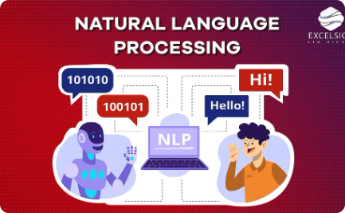
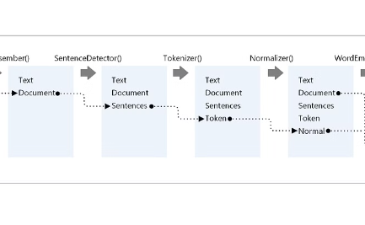
Robust Language Identification
Multilingual Datasets
Advanced Algorithms
Integrated Pipelines
Leveraging diverse datasets to train robust language identification models.
Exploring novel machine learning algorithms for improved language detection accuracy.
Integrating language identification into comprehensive NLP processing pipelines.

Slide 11
The Future of NLP Language Identification
Emerging Trends
Challenges
Opportunities
Multilingual models
Low-resource languages
Personalized language detection
Transfer learning
Code-switching
Multimodal language identification
Unsupervised learning
Dialects and variants
Real-time language processing

Slide 12
Conclusion and Future Directions
Continuous Improvement
Multimodal Approaches
Ethical Considerations
Integrating language identification with other modalities, such as speech, audio, and images, will enable more holistic and contextual language understanding.
Ensuring language identification technology is developed and deployed responsibly, addressing issues of bias, privacy, and fairness.
Advancements in deep learning, transfer learning, and multilingual modeling will enhance the accuracy and robustness of language identification systems.

